Slide 1

Department of Information Technology
NBA Accredited A.P. Shah Institute of Technology G.B.Road,Kasarvadavli, Thane(W), Mumbai-400615 UNIVERSITY OF MUMBAI Academic Year 2022-2023

Slide 2
A Project Report on Machine learning -Based Student Activity Monitoring System For An Educational Institute.
Submitted in partial fulfillment of the degree of Bachelor of Engineering(Sem-8) in INFORMATION TECHNOLOGY By Janhavi Kulkarni(19104062) Simran Choudhary(19104023)
Loveritu Itnare(19104028) Under the Guidance of Name of Guide- Dr. Kiran Deshpande

Slide 3
Machine Learning-Based Student Activity Monitoring System For An Educational Institution.

Slide 4
1.1 Abstract
The presentation introduces the related work of face recognition from different perspectives.
The institute's norms and regulations are frequently broken or ignored by students.
To avoid such violation of rules we are building the Activity Monitoring System which will ameliorate the pace by which these can be limited to an extent.
The process will start as the respected authority or professors will click the picture of the student caught doing any mischief.
This information will be uploaded to the portal. Once the specifications are imported into the application developed, the face will be collated and recognized by the database.
The portal will display basic information about the respective student using face recognition which will be sent to the respective HODs via E-mail for further decisions.
We intend to integrate the use of face recognition in student data modules to detect student identity.

Slide 5
1.2 Objectives
We intend to do this project implementation to meet the following objectives:
To design and develop a comprehensive cross-platform application for monitoring and identifying students involved in notorious activities.
To orchestrate the use of Machine Learning in the application developed for tracking students’ notorious activities.
To orchestrate the use of Cloud Computing for providing scalability to a comprehensive student monitoring system developed.

Slide 6
1.3 Literature Review
Sr no. | Paper title | Author | Abstract
1. | Deep Unified Model For Face Recognition Based on Convolution Neural Network and Edge Computing IEEE 2019 | M. Z. Khan, S. Harous, S. U. Hassan, M. U. Ghani Khan, R. Iqbal and S. Mumtaz | This paper proposes an algorithm for face detection and recognition based on convolution neural networks (CNN), which outperform traditional techniques.
2. | A Review of Face Recognition Technology IEEE 2021 | R. Sharma, V. K. Sharma and A. Singh | This paper described the development stages and related technologies of face recognition, including early algorithms, artificial features and classifiers, deep learning .They have used is a simple process of feature extraction where PCA is combined with face recognition by using K-Nearest-Neighbor (KNN) algorithm

Slide 7
SR.NO | Paper title | Author | Abstract
3. | Multi-view intrinsic low-rank representation for robust face recognition and clustering IEEE 2022 | Wang, Zhi‐yang, Abhadiomhen, Stanley & Liu, Zhi‐feng & Shen, Xiang‐jun & Gao, Wen‐yun & Li, Shu‐ying | The Author have developed a framework for automatic face recognition based on CCTV images using different machine learning algorithms in this work.
4. | A Real-Time Framework for Human Face Detection and Recognition in CCTV Images IEEE 2021 | Rehmat Ullah Hassan Hayat Afsah Abid Siddiqui Uzma Abid Siddiqui Jebran Khan Farman Ullah Shoaib Hassan Laiq Hasan Waleed Albattah Muhammad Islam | In this paper, the author proposed a novel multi-view low-rank representation method. The method follows hierarchical Bayesian methods and learns intrinsic and specific representation among each view via a consistent structure and diversity regularization.

Slide 8
1.4 Problem Definition
It becomes difficult for the security guard to identify the students who do not carry their Id cards.
Problem Identified is that students are not wearing identity card and are practicing mischievous activities in college campus.
Faculty sometimes see students misbehaving and roaming but the faculty cannot identify the respective department.
To overcome this, we have proposed a system in which we will add image of individual so that it will be easy to find the student and revert their details to authorities quickly.

Slide 9
1.5 Scope
Developing an application for monitoring student activity in college can have a wide scope.
It can address various aspects of maintaining discipline in institute.
The app allows the college administration to upload the image of students , and view their details.
The app can help by ensuring that records of activities are maintained digitally with time and date which can also help in avoiding any loss on students end.
The app can also be used to send email notifications to the respective Head of the department regarding the basic student details.
The app can be used to maintain decorum of the institute by allowing faculties to report any misconduct or violations of college rules .

Slide 10
1.6 Technology stack
Android Studio
Machine Learning algorithm
Classifiers
SQL
Python
Java

Slide 11
1.7 Benefits for environment & Society
Reduced paper usage: A face recognition system can help reduce the use of paper-based records, which can have a positive impact on the environment by reducing the amount of paper waste.
Time-saving: The face recognition system can save time for faculty by eliminating the need for manual tracking.
Enhanced security: A student monitoring system can enhance safety and security in the institution by preventing unauthorized individuals from entering the premises. This can create a safer environment for students, faculty, and staff.
Better communication and transparency: The system can provide real-time information about student detail to faculty members, allowing them to communicate more effectively with students and their parents more effectively, providing timely feedback and guidance.
Data analysis: A face recognition system can gather data about student attendance. This data can be analyzed to identify trends and patterns that can be used to improve the learning experience for students and inform institutional decision-making

Slide 12
2. Project Design

Slide 13
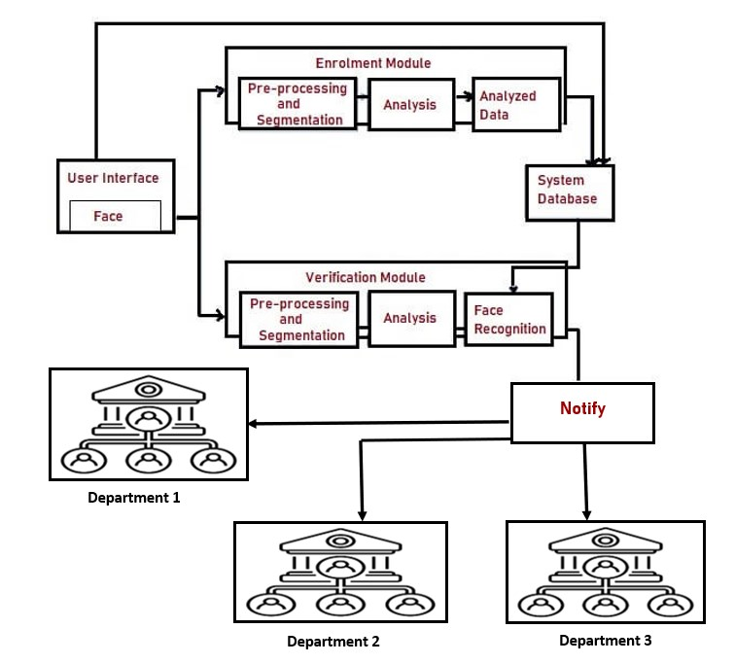
2.1 Proposed System
Enrolment Module:- The enrollment module records student details and clicks 20 images of the student and updates it to the database.
Database:- The student activity monitoring system uses MySQL for the storage of the students as well as the faculty data and their Login Credentials.
Identification Module:- The Activity monitoring system application is connected to the modules Matplotlib, Pickle, Numpy, and utils for image processing functions like rotating, etc. Opencv, cmake, face-recognition, and pillow are mainly used for face recognition and identification in the project.

Slide 14
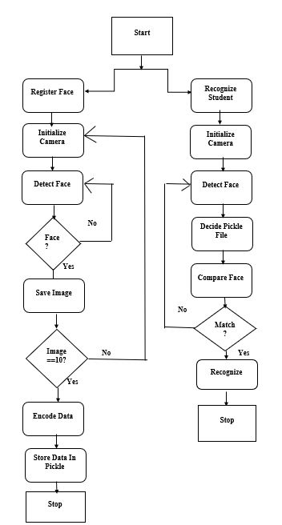
2.2 Design(Flow Of Modules)
The system takes 10 images of each student as a database and uses them to train the model for identification.
The data is stored in Pickle. For the recognition of the students, the mobile applications camera is initiated and the required student's face is captured or uploaded by the faculty for monitoring purposes.
If the student is registered, the application will detect using the required pickle file and the system will recognize the student by providing Basic details of the student, or else it will show the message as unknown.

Slide 15
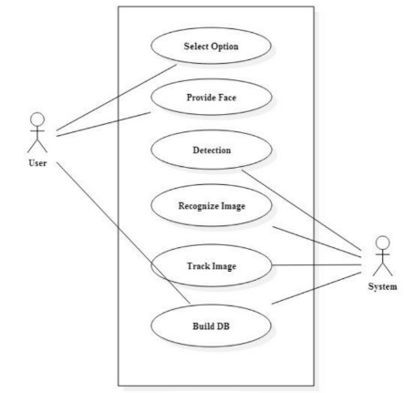
2.3 Description Of Use Case
A use case diagram for face recognition includes actors such as users and administrators and use cases such as registering a face, recognizing a face, managing users, and managing system settings.
The diagram provides a visual representation of how users interact with the system and how the system operates. The use case diagram helps to identify the key features of the system and how they work together to provide the desired functionality.
This enables developers and designers to create a system that meets the needs of the users and is easy to manage and maintain.

Slide 16
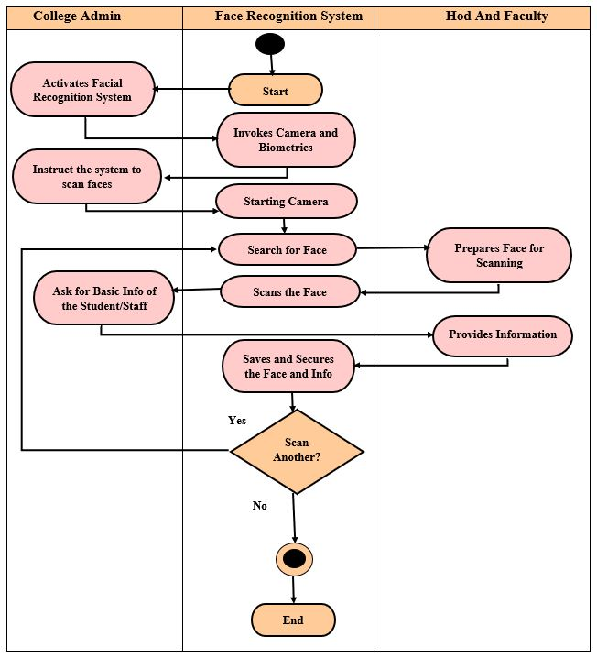
2.4 Activity diagram
The face recognition system activity diagram represents the behaviour of the project in terms of its activities. It contains important details on the activities and constraints done in the project.
This diagram shows the flow of interaction between the system and Admin-User(HODs and Faculty). This is done by helping them visualize the system’s functionality in various degrees of detail.

Slide 17
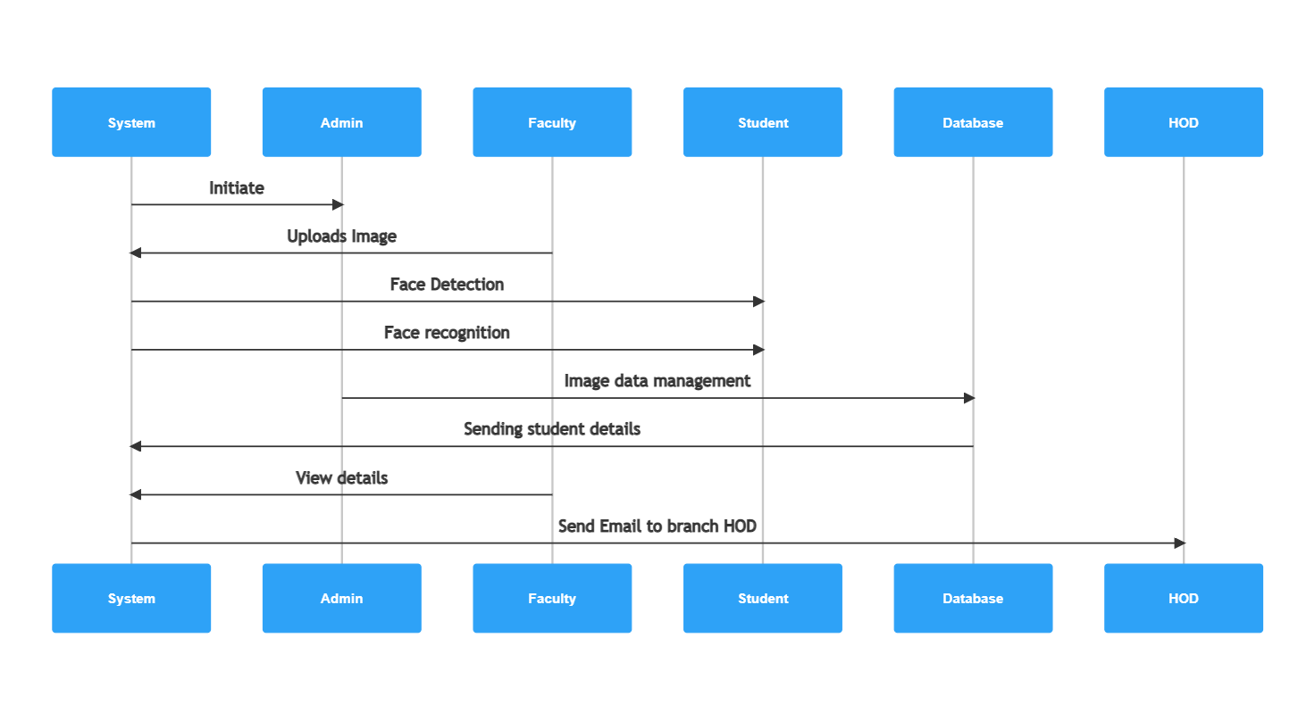
2.5 Sequence Diagram
In this sequence diagram, the user initiates the face recognition process by requesting that the system recognize their face.
The system prompts the user to provide an image, which the user then provides.
The system retrieves a list of stored face images from the database and uses an algorithm to compare the input image to the stored images.
The algorithm applies additional filters to the list of potential matches, such as a confidence threshold, and returns a list of final matches to the system.
Finally, the system displays the match results to the user.

Slide 18
3. Implementation

Slide 19
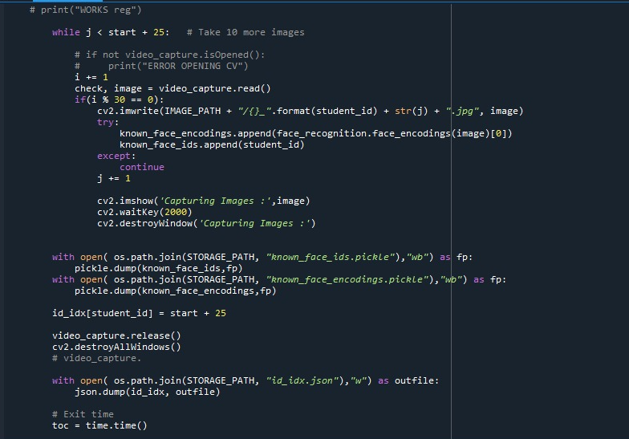
Image 1
Fig 4.4 is the most important part of the code as here the 20 images are captured and trained by using the DNN model which is the second most important turning point of the project.

Slide 20
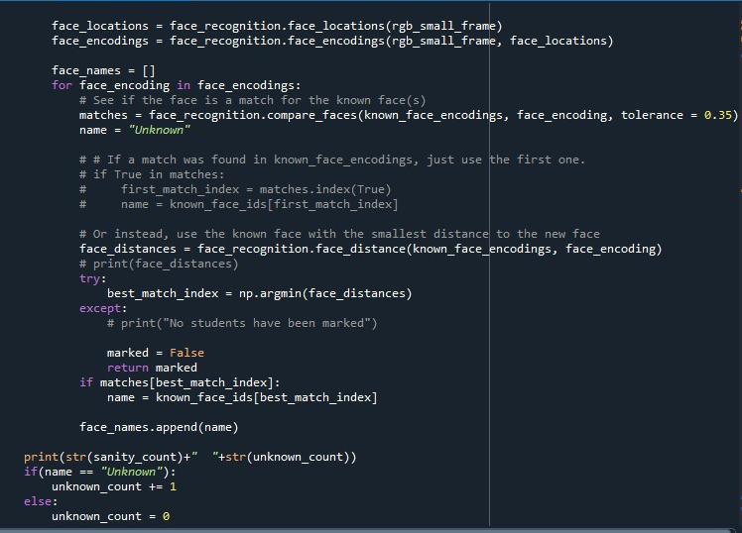
Fig 2 is the Final step before the result is declared and it is the cross-checking of the presence of Face images in the model. This helps in detecting the student details with accuracy irrespective of the angle and background.
Image 2

Slide 21
4. Testing
Test Condition | Test Steps/Procedure | Test Data | Expected Result | Actual Result | Pass/Fail
Login/Register | Pass all inputs | Check validation | Properly validate | Validation successful | Pass
Registering Face Data | Capturing 10 images | Checking if the face is detected | Train model on Face data | Create a Folder of that user and store 10 images and train models | Pass
Predicting data from face | Pass captured image from mobile | Checking the image is clear as much as its face value is detected. | Predicting username from face data. | Prediction of user successful. | Pass

Slide 22
5. Result
When the System is executed the application is accessible to the Users, they could be any faculty in need of student information. When they upload an image on the application after login they receive the student details and if it is not present in the database then on the application screen it shows ”Unknown”.

Slide 23
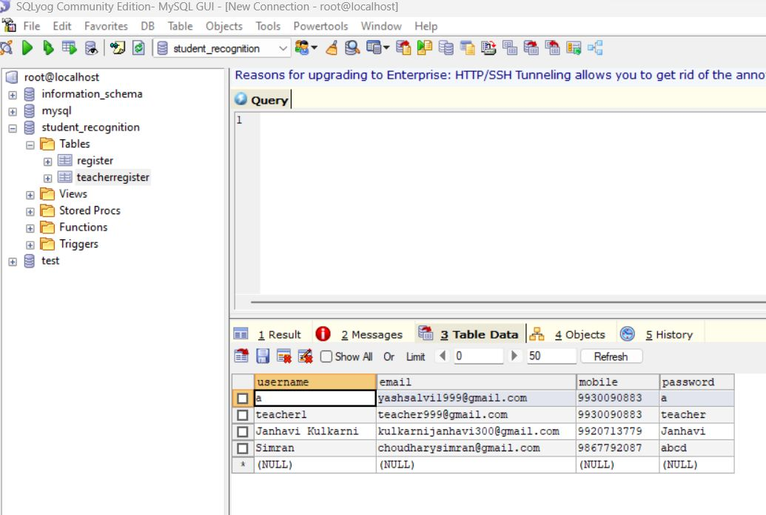
The student activity monitoring system uses MySQL for the storage of the students as well as the faculty data and their Login Credentials. It consists of three tables namely 1. Email data which stores the Email Ids of the HODs from various Branches. 2. Teach Register stores details of the faculties who can enroll the students. 3. Register which contains student data.
Image 3

Slide 24
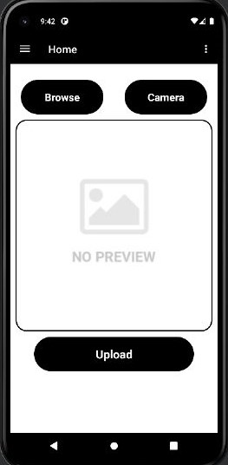
Firstly as the mobile application progresses there is a login and Sign-up page, then comes the next step of the image which is to be uploaded or captured from the mobile device in the application for it to detect the student. Then the picture is uploaded and sent to the respected faculty and is also added to the database for the record. Also it uses modules like face recognition, dlib, pillow, matplotlib and scikit-image for identification
Image 4

Slide 25
6. Conclusion and Future Scope
An efficient and proprietary Activity Monitoring system was designed with the help of Machine Learning and Face Recognition. The application targets mainly Educational Institutions ameliorating the safety and discipline in the respective institutions. Such monitoring system turns out much more beneficial for educational Institutes. It will make it easier for the respective faculty to keep a check on the student activities.
It plays a vital role in maintaining the discipline of the institute as it is quite flexible. On a large scale, this approach can be implemented in corporate offices, Businesses, and retail industries.
The Student Activity Monitoring System will be updated with the addition of the notification which is sent to the respective student as a warning.

Slide 26
References
M. Z. Khan, S. Harous, S. U. Hassan, M. U. Ghani Khan, R. Iqbal and S. Mumtaz, "Deep Unified Model For Face Recognition Based on Convolution Neural Network and Edge Computing," in IEEE Access, vol. 7, pp. 72622-72633, 2019, doi: 10.1109/ACCESS.2019.2918275.
R. Sharma, V. K. Sharma and A. Singh, "A Review Paper on Facial Recognition Techniques," 2021 Fifth International Conference on I-SMAC (IoT in Social, Mobile, Analytics and Cloud) (I-SMAC), Palladam, India, 2021, pp. 617-621, doi: 10.1109/I-SMAC52330.2021.9640896.
Wang, Zhi‐yang & Abhadiomhen, Stanley & Liu, Zhi‐feng & Shen, Xiang‐jun & Gao, Wen‐yun & Li, Shu‐ying. (2021). Multi-view intrinsic low-rank representation for robust face recognition and clustering. IET Image Processing. 15. 10.1049/ipr2.12232.
Ullah, Rehmat & Hayat, Hassan & Siddiqui, Afsah & Siddiqui, Uzma & Khan, Jebran & Ullah, Farman & Hassan, Shoaib & Hasan, Laiq & Albattah, Waleed & Islam, Muhammad & Karami, Mohammad. (2022). A Real-Time Framework for Human Face Detection and Recognition in CCTV Images. Mathematical Problems in Engineering. 2022. 10.1155/2022/3276704.

Slide 27
Paper Publication
Paper entitled “Machine Learning-Based Student Activity Monitoring System for an Educational Institution” is Submitted -ICSCSS Conference; “In process of publication” by “Janhavi Kulkarni, Simran Choudhary, Loveritu Itnare”.

Slide 28
Thank You

